Slide 1
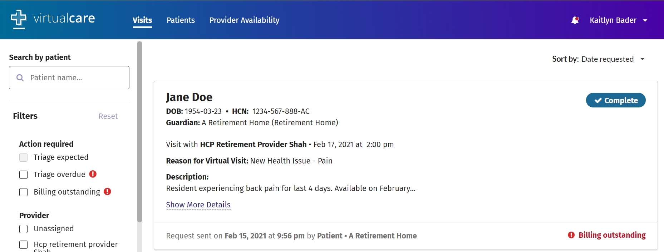
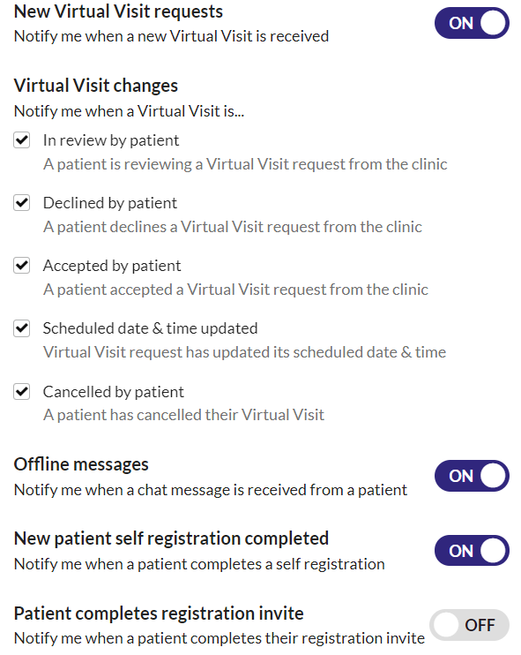
VirtualCare Account Set-up Checklist
^{CLINIC ADMINS}
Setting up your VirtualCare Account
Please complete the steps below to ensure you are fully set up to begin scheduling virtual visits. These steps will only need to be done once upon logging in to VirtualCare for the first time.
Login to VirtualCare.
You will be prompted to review and accept the end user license agreement.
You will be taken to the “Visits” page where you can manage upcoming virtual appointments with residents.
Click on your name in the top right hand corner of the screen and select “Account Settings”.
Click on “Notifications” and configure your email and in-app notification preferences.
Congratulations!
You’re all set up on VirtualCare!
TECHNICAL SUPPORT
Kaitlyn Bader, Senior Implementation Specialist
Ph: 647.362.0041, Ext. 340
Email: kaitlyn.bader@thinkresearch.com

