Slide 1
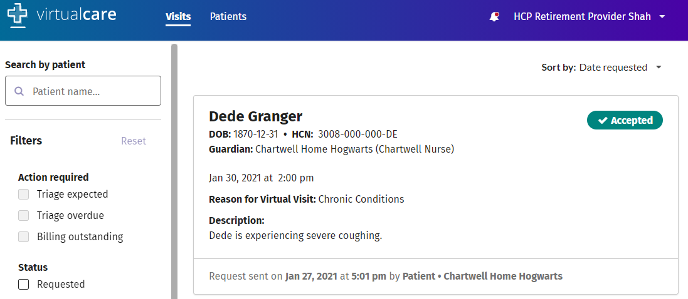
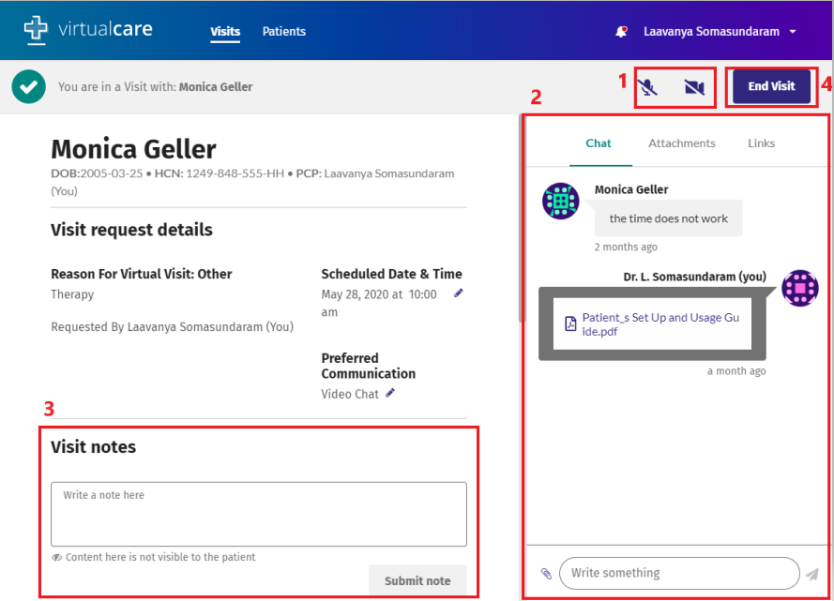
VirtualCare Quick Reference Guide
^{FOR PHYSICIANS}
1) CONDUCTING THE VISIT
Once the visit request has been accepted by the HCP staff, and both the physician and home are in the virtual room, the appointment can proceed.
A. When you are ready to initiate the visit, locate the visit request in your Visits list and click anywhere on the visit to enter the virtual room. The home staff will also need to complete the same steps with the resident.
B. Once in the room, you will have the option to:
1.Initiate audio/video communications
2.Send chat messages and attachments (e.g., confirming prescriptions have been sent to pharmacy, attaching requisitions for the patient)
4.When you are finished with the virtual visit, click the ‘End Visit’ button to mark the visit as complete
Microphone and camera buttons: To hear and see your patient during the visit, both you and the home must enable the microphone and video cameras by clicking on the associated icons. Once enabled, the line through the icon will disappear.
Chat window: You can send chat messages, attachments, and links to the home before, during, and after the virtual visit.
Visit notes: All visit documentation will be completed in the EMR. Therefore the visit notes area does not need to be used.
End Visit button: Once the visit is complete, you can click to end the visit and close the chat window.
TECHNICAL SUPPORT
Kaitlyn Bader, Senior Implementation Specialist
Ph: 647.362.0041, Ext. 340
Email: kaitlyn.bader@thinkresearch.com

Slide 2
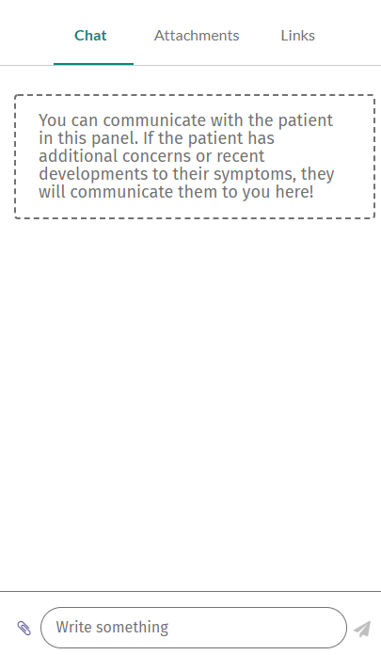
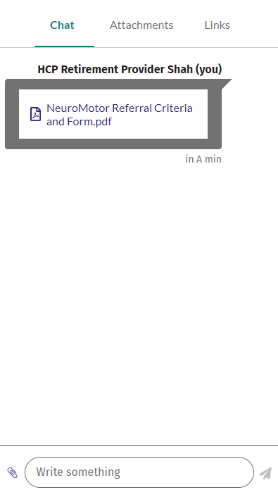
ADDITIONAL FORMS (i.e. Cardiology, Diagnostic Imaging, etc.)
Additional forms that need to be sent over to the home can be done so through the chat window in the virtual visit room. Once you have completed the form on your computer, click on the paperclip icon at the bottom left of the chat window.
Your computer’s file explorer will open by default and allow you to select the form you would like to attach (once filled out first). Double click the form you would like to send.
The form will be sent as an attachment directly to the home within the chat window where they will be able to access it for reference.
TECHNICAL SUPPORT
Kaitlyn Bader, Senior Implementation Specialist
Ph: 647.362.0041, Ext. 340
Email: kaitlyn.bader@thinkresearch.com

